Slide 1
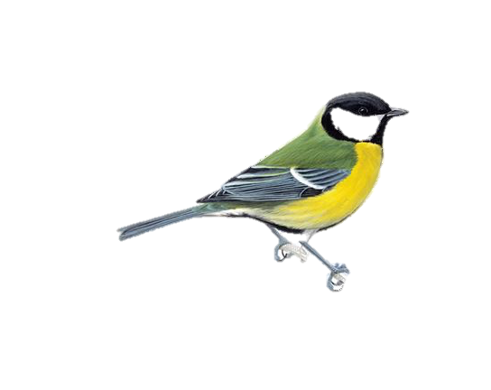
Nest box visitation variation in wild great tits
Kathryn Grabenstein
Independent Project
16 April 2019

Slide 2
Why visit multiple sites?
In birds, individuals visit multiple potential nesting locations prior to the breeding season but unknown if for:
Information gathering
Competition for sites
Extra-pair mating

Slide 3
What is the frequency of nest box visits for individuals based on demographic characters?
How many unique nest boxes do individuals visit?
How does this vary with age, sex & breeding status?
What boxes do individuals prefer?
Do visitations to preferred boxes vary based on demography?

Slide 4
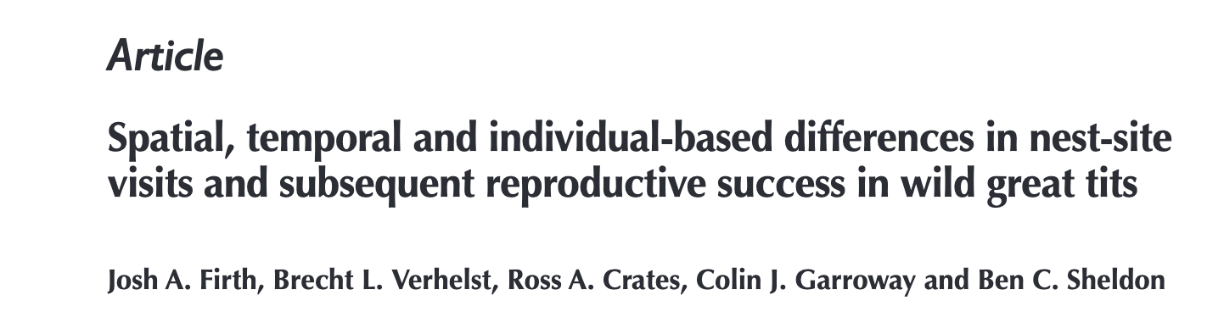
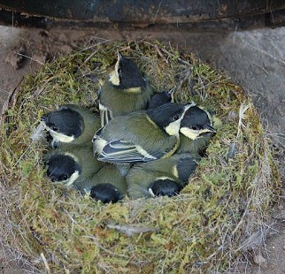

Slide 5
Show me the data
>3,000 observations of individuals visiting nest boxes
Each row is single individual’s visit
Tag ID, date, sex, age, box, 'Day'= the day of this visit by this individual to this nestbox (days since Feb 1st), 'diff'= the number of days difference between the day of this visit by this bird to this box and the day it laid its first egg

Slide 6
Analysis
1. Using the *obs.dryad* file, I will first tally the number of visits to unique boxes for each individual
2. I will then assess the relationship between unique nest boxes visited by an individual and its age, sex, and breeding status.
3. I will graph visits to unique nest boxes by age, sex, & breeding status

Slide 7
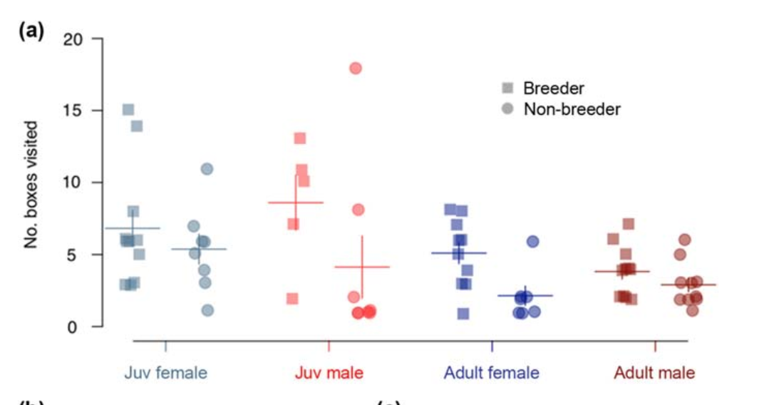
Analysis

Slide 8
Anticipated Results
Shed insights into demographic factors associated with nest site scouting prior to breeding season
Describe variation in nest box visitation rates across pre-breeding season

